Slide 1
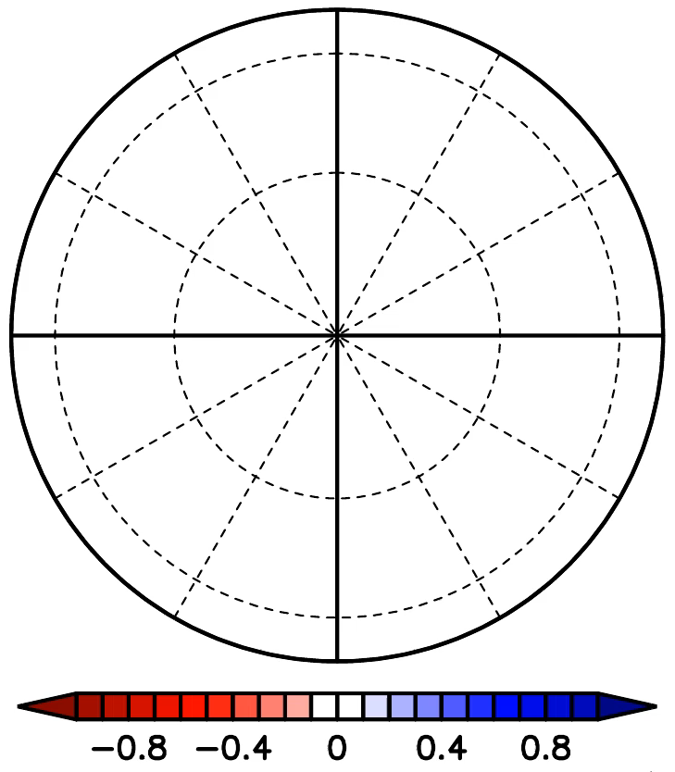


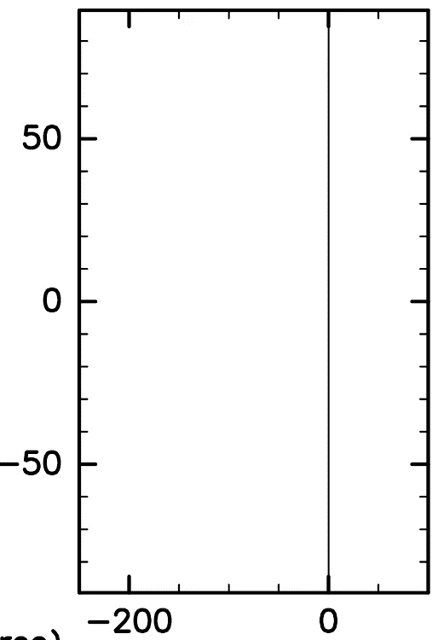





$$τ_{APE}={10}^{6}$$
$$τ_{APE}={10}^{5}$$
$$τ_{APE}={10}^{3}$$

